Slide 1
BE PROJECT PRESENTATION
ON
“EMA (Emotional and Mental Analyst)”
Presented By
Name : Durgesh Patil Roll No:-BI45
Name : Dhanashree Kulkarni Roll No:-BI38
Name : Sujata Junare Roll No:-BI28
Name : Utkarsh Bhangale Roll No:-BI03
Under the guidance of
Prof. “Nitin Dhawas”
Department Of Information Technology
01

Slide 2
Contents
Introduction
Motivation & Objective
Problem statement
Existing system
Literature Survey
Proposed system
System overview/Architecture
Implementation
Algorithm & Mathematical model
System Specification
Conclusions
References
Department Of Information Technology
02

Slide 3
Introduction
We are introducing a human like A.I. chatbot which recognizes the emotions of the user by interacting with simple conversation and analyze what abrupt thoughts might lay in the user's mind. The user may name the bot anything he likes and shares his emotions, his thoughts, his psychological dilemmas with it and seek for solution. The bot will analyze what the user is dealing with and provide the user with comforting words, fun games, jokes, daily mood tracker and much more stuff that will ease the user's nerves.
Department Of Information Technology
03

Slide 4
Motivation & Objectives
To understand the users complex and conflicting thoughts.
To analyze the users state of mind.
To provide a confidential trustworthy medium for the users to organize their thoughts with life-like interaction.
To provide remedial exercises and routines to eliminate disputing thoughts form users mind and avoiding any self-harm causing intentions of the user.
Department Of Information Technology
04

Slide 5
Problem Statement
To develop a programmed chatbot which will form a conversational interaction with the user and analyze the current emotional crises the user is dealing with hence providing solutions or mental exercises for eliminating adverse and repugnant thoughts form the user's mind.
Department Of Information Technology
06
Notes:
5

Slide 6
Existing system
Chatbot which just chat to user with a flow.
According to more chatting experience system can analyze person.
User can communicate via text mostly.
Chatbot cannot give accurate mood as it is only text based(sometimes audio is also used but rate is negligible).
User need to provide personal information like mobile number,
Email ID etc.
Department Of Information Technology
07

Slide 7

Department Of Information Technology
09

Slide 8
SR.NO | TITLE | PUBLICATION YEAR | AUTHOR | ALGORITHM | KEYWORDS
1. | Combating Depression in Students using an Intelligent ChatBot: A Cognitive Behavioral Therapy | ©2019 IEEE | Falguni Patel, Riya Thakore, Ishita Nandwani, Santosh Kumar Bharti | Convolutional Neural Network (CNN) , Recurrent Neural Network (CNN) , and Hierarchical Attention Network (HAN) | Artificial Intelligence, Depression, Natural Language Processing, Students, Therapeutic Chatbot.
2. | Model of Multi-turn Dialogue in Emotional Chatbot | ©2019 IEEE | Chien-Hao Kao, Chih-Chieh Chen, Yu-Tza Tsai | CNN, RNN and HAN | Multi-turn; Emotional category; Seq2Seq;. SeqGAN;
3. | Deep learning based Text Emotion Recognition for Chatbot applications | ©2020IEEE | Mounika Karnaa , Sujitha Juliet D.b , R.Catherine Joyc | LSTM Long-Short Term Memory | Emotion recognition, Text based analysis, Online Chatbot, text mining, LSTM, deep learning
Department Of Information Technology

Slide 9
Proposed system
System can talk to user according to recognized mood of
mood and mental state.
Communication via audio and face is new mode of communication for chatbots.
System will suggest some tips to make user happy .
System will calculate current mood according to facial
expression and communication .
Department Of Information Technology
08
Notes:
9

Slide 10
Libraries and Features
Tensorflow
Numpy
OpenCV
gTTS
Matplotlib
Department Of Information Technology

Slide 11
Algorithm
First, the haar cascade method is used to detect faces in each frame of the webcam feed.
The region of image containing the face is resized to 48x48 and is passed as input to the CNN.
The network outputs a list of softmax scores for the seven classes of emotions.
The emotion with maximum score is displayed on the screen.
According the emotion detected, the question will be asked by chatbot.
After taking a user’s response in the audio format, it will be converted into text using gTTS API
Split Sentences into words.
Search for a word in a database and give appropriate response into audio format.
Department Of Information Technology

Slide 12
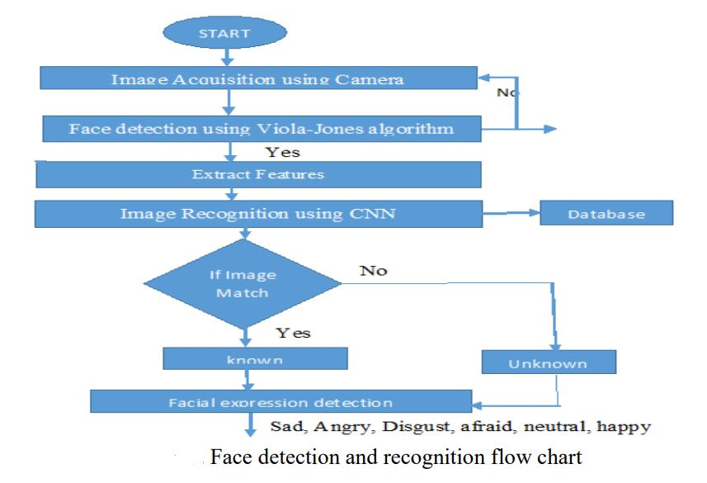
Department Of Information Technology

Slide 13
Initialize
Webcam
Face Detection
Using haar cascade features
Automated
marker
feature
Save the
initial coordinates
and marker
features
Start
Start
Ask Question
using keyword search
Emotion Detection
Classification
(CNN)
Feature
Extraction
Save Response
Happiness
Sad
Take the
Average
emotion and
show the
result
Anger
End
Disgust
Surprised
Fear
Neutral
Department Of Information Technology

Slide 14
Emotion Detection using Haar-Cascade and CNN
Haar Cascade
Detect Face
Crop and convert into 48*48 size
Fully connected
Pooling
CNN
Convolution
SoftMax Score
Emotion Detection
Department Of Information Technology

Slide 15
Conclusion
An image processing and classification method has been implemented in which face images are used to train a dual classifier predictor that predicts the seven basic human emotions given a test image. the predictor is relatively successful at predicting test data from the same dataset used to train the classifiers. we presented our work on text-based emotion classifications using different methods. the advantage of our system is that it is not only based on the single word in the sentence, but it also takes in to the surrounding words and then depicts the result. moreover it considers users’ experiences thanks to the historical data component. future will consist in comforting the efficiency of the proposed textual emotion deduction modality to existing system. and also to add more emotions other than those features we have used in this paper. the best feature extraction techniques may improve the classification performance.

Slide 16
References
Priya Dwivedi , Face Detection, Recognition and Emotion Detection in 8 lines of code!, towardsdatascience.com, April 3, 2019
Facial emotion recognition using convolutional neural networks (FERC) Ninad Mehendale February 2020
Matsumoto, D. & Kupperbusch, C. Idiocentric and allocentric differences in emotional expression, experience, and the coherence between expression and experience. Asian Journal of Social Psychology (4), pp. 113-131 (2001).I.S. Jacobs and C.P. Bean, “Fine particles, thin films and exchange anisotropy,” in Magnetism, vol. III, G.T. Rado and H. Suhl, Eds. New York: Academic, 1963, pp. 271-350.
YasminaDouiji and HazarMousanifI-CARE - Intelligent Context Aware system for Recognizing Emotions from text
An Emotion Recognition Model Based on Facial Recognition in Virtual Learning Environment D. Yanga , Abeer Alsadoona , P.W.C. Prasad*a , A. K. Singhb , A. Elchouemic

